Slide 1

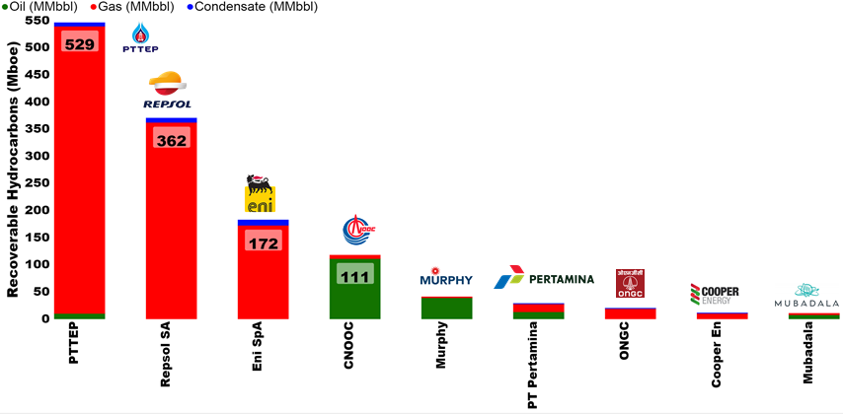
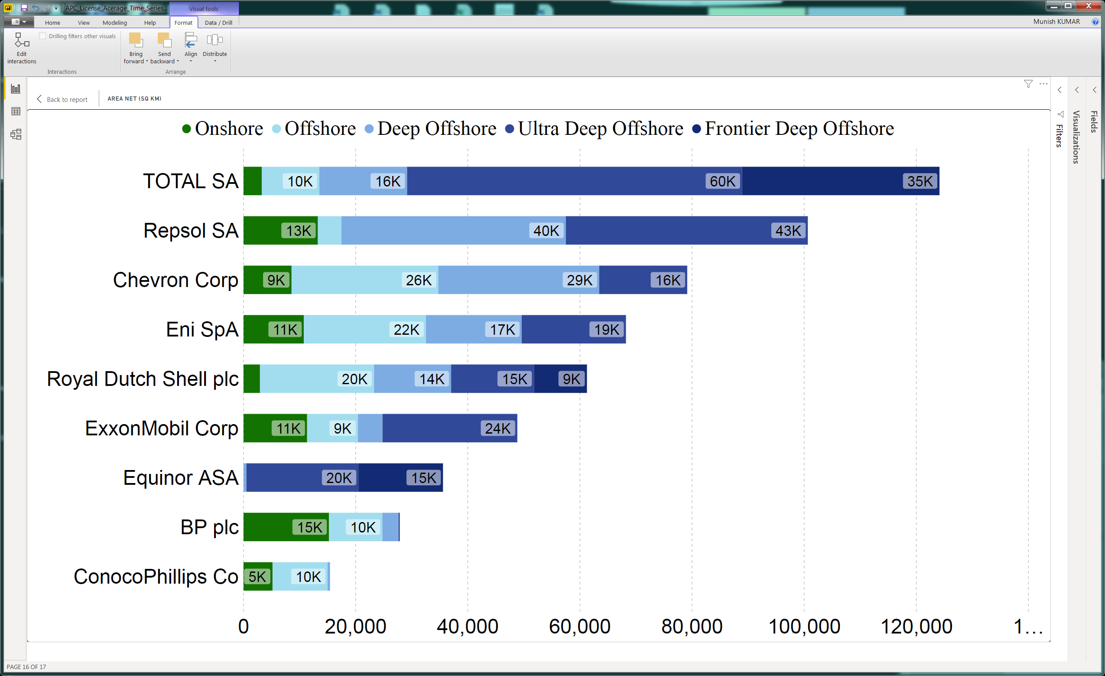
SUSS Associate faculty: Dr Munish Kumar
Email: munishkumar001@suss.edu.sg
Academic Qualification:
Ph.D. Physics, Australian National University
Courses taught at SUSS:
ANL201 Data Visualisation for Business
Research Interest/ Projects:
Application of Data and visualisation in Oil and Gas, Energy, Renewables Sector
Tools of the trade: Power BI & Python, Tableau.
Only available on Tuesday night.

Slide 2



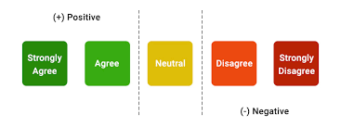





The Good , the Bad & the Ugly
The Bad/ Ugly
Measurement Level
Unordered
Ordered Words
No True Zero
Qualitative
Quantitative
Data Types
Nominal
Ordinal
Interval
Ratio
Categorical
Numerical
Discrete
Continuous
2

Slide 3
The Good , the Bad & the Ugly
The Good
Types of Data
Qualitative
Quantitative
Arithmetic
Measuring the data
Nominal
Ordinal
Interval
Ratio
Unordered
Ordered Words
Discrete
Continuous
No True Zero

Slide 4
Getting started with Tableau
Introduction
Tool Set
Data Analysis
Data Visualisation
Core Components
Connect and Prepare (source files, modify, create data)
Analyze & Visualise Data
Dashboard & Stories (combine the information)
Tableau Desktop ≈ Tableau Public
Versioning
Prior to 2018 → Tableau 10.5
Post 2018 → Tableau 2020.4 (where <.#> is maintenance release containing latest features)
User Oriented Tool for Business Intelligence

Slide 5
Getting started with Tableau
Getting Started
First Steps
Installation
Tableau Platform
Developing familiarity
Connect Source Files
Structure Data
Course Information
Clean Data
Data Preparation
Analysis and Visualisation
Dashboards & Stories
Next Steps
Calculations
Data Insights
Visuals
Overview of Results
Tell your Story
Summary
Extract, Transform & Load (ETL)

Slide 6

Key Differences
Tableau Desktop
Tableau Public
Data Storage
Private
Public
Data Sources
Enhanced
Limited
Data Connectivity
Live & Extract
Extract Only
1 way, data is stored in memory
Always
auto updated
Core features are identical

Slide 7
Tableau Desktop Workflow
Connect
Linking to Source Data
Local Data or Databases (e.g. SQL)
Prepare
Cleaning Rows/ Columns
Combine Tables
Analyse & Visualise
Insights through visualisation
Dashboards & Stories
Interactive
Filter Data
Calculate Fields
Combine Multiple Visuals for Story
Data Source
Worksheet
Dashboard

Slide 8
Union – Adding Rows to Data Source
Number | Quantity | Price ($)
1 | 100 | 2
2 | 100 | 2
Number | Quantity | Price ($)
3 | 150 | 3
4 | 150 | 3
Number | Quantity | Price ($)
1 | 100 | 2
2 | 100 | 2
3 | 150 | 3
4 | 150 | 3

Slide 9
Union vs Join
Union
Join
Month | Price | Quantity
Jan | 5 | 10
Month | Price | Quantity
Jan | 5 | 10
Month | Price | Quantity
Feb | 10 | 20
Month | Location
Feb | Bedok
Month | Price | Quantity
Jan | 5 | 10
Feb | 10 | 20
Month | Price | Quantity | Location
Jan | 5 | 10 | Bedok
Adding rows to existing data
Adding Columns to existing data

Slide 10
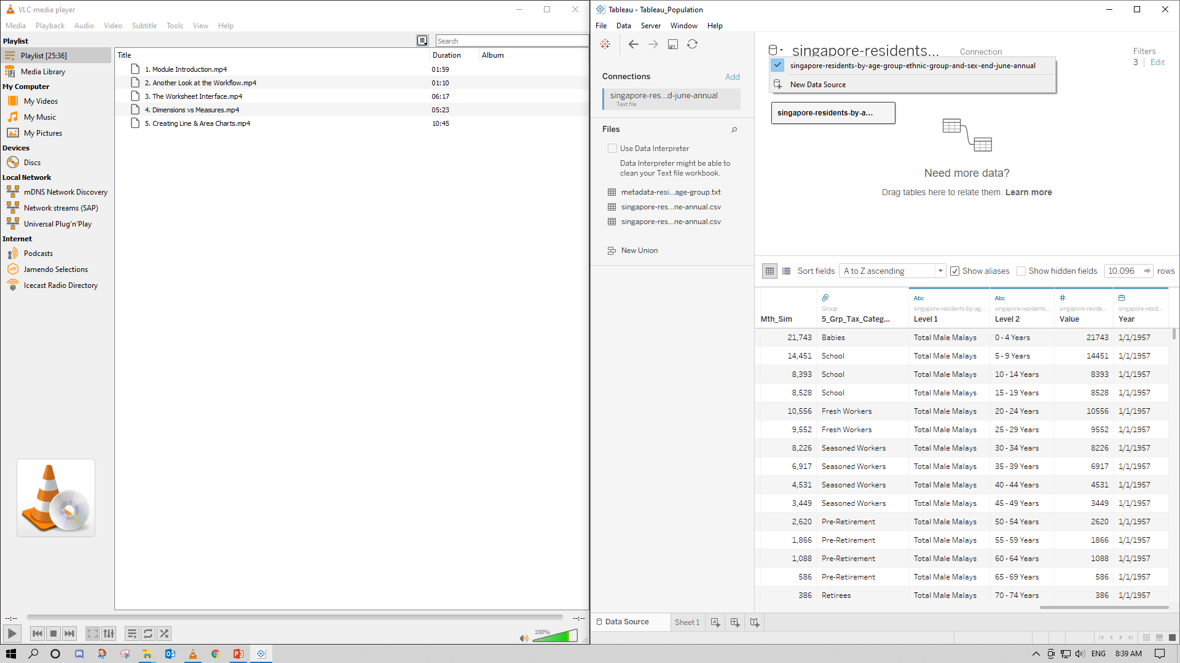
Join – Adding Columns to Data Source
Data Source 1
Connection 1
Connection 2
File 1.csv
File 2.csv
File 3.csv
File 4.csv
X
OK
OK
Data Source 2
X
Connection 1
Data Source Tab
File 5.csv

Slide 11
Join – Adding Columns to Data Source
Data Source 1
Connection 1
Connection 2
File 1.csv
File 2.csv
File 3.csv
File 4.csv
OK
OK
OK
Data Source 2
X
Connection 1
Data Source Tab
File 5.csv

Slide 12
Join Types
Primary Table
Secondary Table
ID | Qty
A | 10
B | 20
C | 30
ID | Reg
A | East
C | West
D | North
Left
Right
Outer
Inner
ID | Qty | Reg
A | 10 | East
B | 20 | null
C | 30 | West
ID | Reg | Qty
A | East | 10
C | West | 30
D | North | null
ID | Qty | Reg
A | 10 | East
B | 20 | null
C | 30 | West
D | null | North
ID | Qty | Reg
A | 10 | East
C | 30 | West
Primary = “Master”
Secondary = “Slave”
Primary = “Slave”
Secondary = “Master”
Equivalent to
Logical “OR”
Equivalent to
Logical “AND”

Slide 13
Pivot Data – Data Source Grouping
Year | Age Group | Population
1959 | 0-4 | 100
1960 | 0-4 | 400
1961 | 0-4 | 700
1959 | 5-9 | 200
1960 | 5-9 | 0
1961 | 5-9 | 100
1959 | 10-14 | 300
1960 | 10-14 | 500
1961 | 10-14 | 200
Year | 0-4 | 5-9 | 10-14
1959 | 100 | 200 | 300
1960 | 400 | 0 | 500
1961 | 700 | 100 | 200
Pivoting reduces the number of columns, and increases the number of rows
However, by grouping data, the data structure and usability improves significantly.
Caveats:
Same Datasource
Same Connection
Excel, Textfile, Google Sheets, .pdf

Slide 14
Categorization – Data Source Groups
Year | Age Group | Population
1959 | 0-4 | 100
1960 | 0-4 | 400
1961 | 0-4 | 700
1959 | 5-9 | 200
1960 | 5-9 | 0
1961 | 5-9 | 100
1959 | 10-14 | 300
1960 | 10-14 | 500
1961 | 10-14 | 200
Year | Age Group | Age-Category
1959 | 0-4 | Child
1960 | 0-4 | Child
1961 | 0-4 | Child
1959 | 5-9 | Child
1960 | 5-9 | Child
1961 | 5-9 | Child
1959 | 10-14 | (Pre)Teens
1960 | 10-14 | (Pre)Teens
1961 | 10-14 | (Pre)Teens
Group
Caveat: You cannot group Aliases.

Slide 15
Calculated Fields – Math in Data Source
Basic
Level of Detail (LoD)
Table
Row
Aggregate
-
-
Create (New) Data
Increase Granularity and Data Prescriptiveness
Ranking, moving, intra-raw calculation
e.g. Calculated Profit from raw Revenue and Cost
e.g. Breakdown of sales by Region
e.g. Moving averages
Data Source Worksheet
Data Source Worksheet
Worksheet

Slide 16
Building Blocks & Syntax – Math in Data Source
Roll | Student | Grade
1 | Ali | 80
2 | Benny | 40
3 | Carrie | 60
4 | Daffy | 50
Calculated
PAS
FAIL
PASS
FAIL
IF [GRADE] > 50 THEN “PASS“
ELSE “FAIL“
END
Functions
Fields
Operators
Literal Expressions
Number ABS(-3) = 3
[GRADE]
>
“PASS”
Strings Len(“Ali”) = 3
Type Conversion INT(50.1) = 50
Logical IF [Ali] THEN “Pass”
https://help.tableau.com/current/pro/desktop/en-us/functions.htm

Slide 17
Visualisation in Tableau
Charts
Dimension vs
Measure
Relationships &
Data Blending
LoD Expressions
& Table Calculation
Sets, Bins &
Parameters

Slide 18




Dimensions vs Measures
Dimension
Measure
Qualitative
Quantitative
Slicing/ Filtering
Calculation
No Summation
Summation
Project
Age Group
Salary
Country
Long/ Lat
Year
Population

Slide 19
Relationships & Data Blending
Primary Table
Secondary Table
ID | Qty
A | 10
B | 20
ID | Reg
A | East
B | West
Single Data Source
JOIN
ID | Qty
A | 10
B | 20
Data Source 1
RELATIONSHIP
Only Dimensions, not Measures
ID | Reg
A | East
B | West
Data Source 2

Slide 20
Understanding Types of Data
Types of Data
Qualitative
Quantitative
Arithmetic
Measuring the data
Nominal
Ordinal
Interval
Ratio
Unordered
Ordered Words
Discrete
Continuous
No True Zero

Slide 21
Groups & Sets
Group
Set
Combine Members
Categorise Members
Fixed
(Enumerated)
Computed
(Dynamic)
Combined
Manually
Using Conditions
Oil = “Yes”
Manual selection directly on visual
Based on General Condition
Based on Multiple Sets
Boiled Veges
Meal
Boiled Veges
“Out”
Fried Rice
Fried Rice
“In”
Grilled Meat
Grilled Meat
“Out”

Slide 22
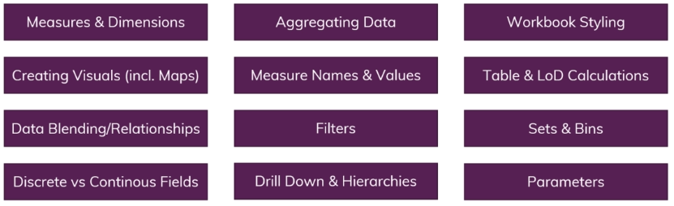
Module Summary

